Slide 1

AI Discovery Day
Notes:
b

Slide 2
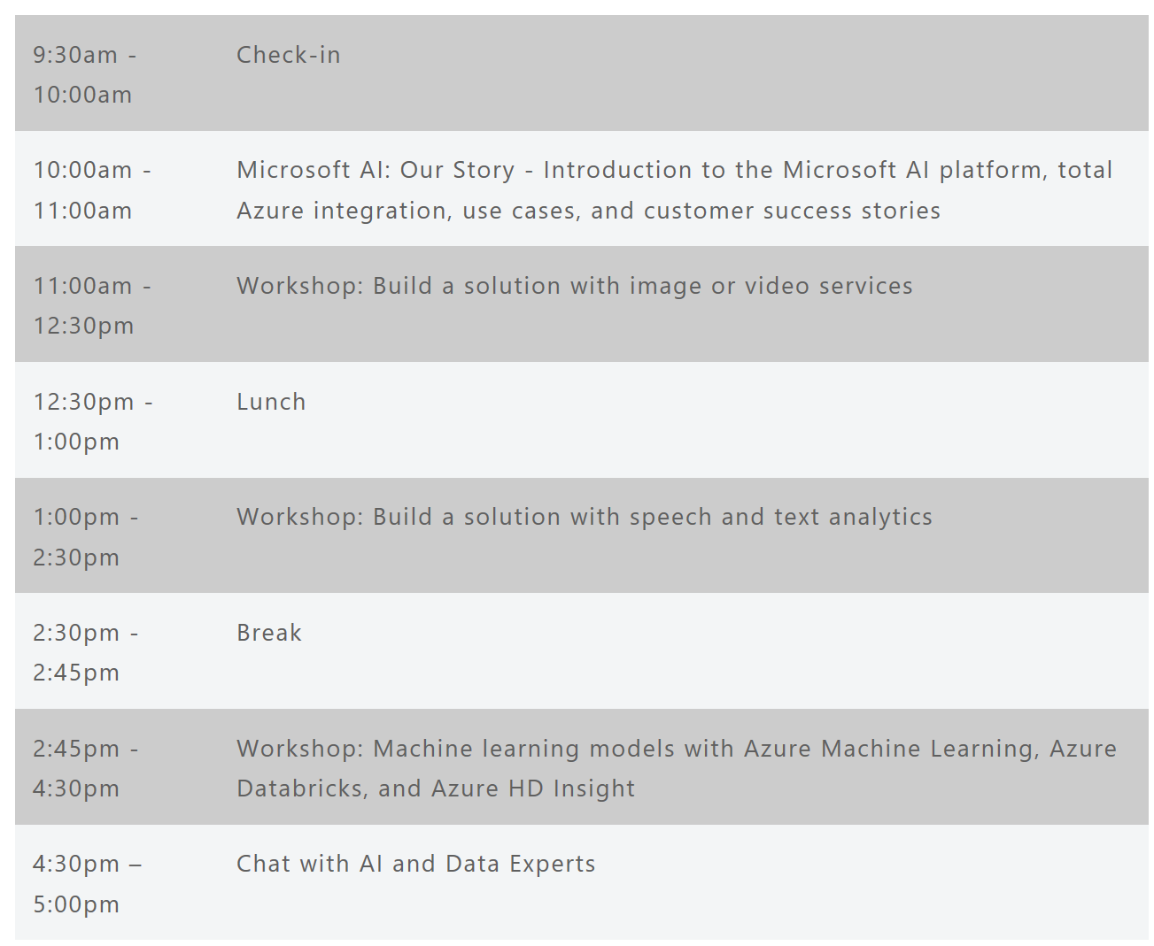
Event Agenda:

Slide 3
Azure AI

Slide 4
Azure Data + AI
Data
AI
Data Modernization on-premises
AI apps & agents
Data modernization to Azure
Knowledge mining
Globally distributed data
Machine learning
Cloud Scale Analytics

Slide 5
Customized language understanding
Text-to-speech
Content moderation
Spell check
Speech translation
Custom image classification
AI
Speaker recognition
Entity linking & augmentation
Vision
Speech
Language
Sentiment analysis, key phrase extraction
Image tagging
Custom voice
Object detection
Text translation
Intend analysis
OCR handwriting recognition
Emotion detection
Video insights
Custom translation
Face identification
Assisted text moderation
Custom speech
Speech transcription

Slide 6


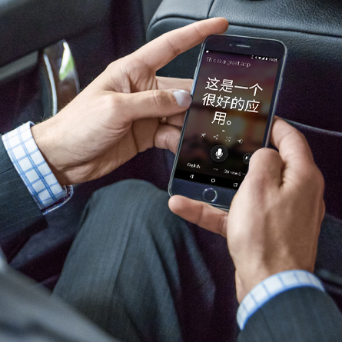

Microsoft AI breakthroughs
Vision
Speech
Language
Switchboard
Meeting speech
96%
RESNET vision test 152 layers
5.1%
Switchboard speech recognition test
69.9%
MT research system
88.5%
SQuAD reading comprehension test
Broadcast speech
Switchboard cellular
IBM Switchboard
2016
Object recognition Human parity
2017
Speech recognition Human parity
March 2018
Machine translation Human parity
January 2018
Machine reading comprehension Human parity
1993
2000
2006
2010
2017

Slide 7
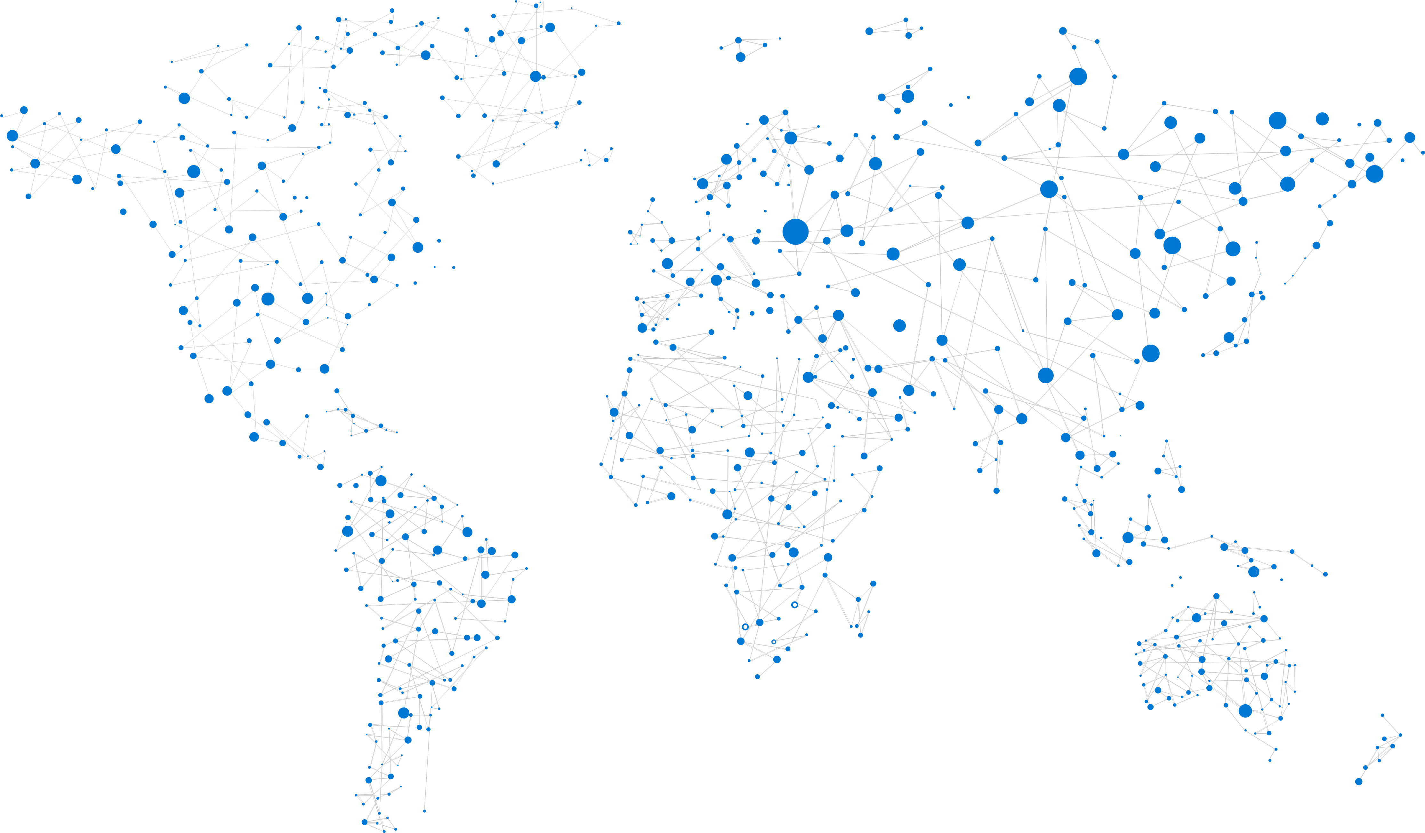
Azure
Productive | Hybrid | Intelligent | Trusted
Notes:
54 regions

Slide 8







Azure is the best place for AI
Accelerate time to value
with agile tools and services
Innovate with AI everywhere
in the cloud, at edge and on-premises
Use any language, any development tool and any framework
Benefit from industry leading security, privacy, compliance, transparency and AI ethics standards
>90% of Fortune 500 companies use Microsoft Cloud
Pretrained AI services
Powerful
tools
Comprehensive
platform
Cloud
Edge
On-premises

Slide 9
Azure AI
AI apps & agents
Knowledge mining
Machine learning
Azure Bot Service
Azure Cognitive Services
Azure Cognitive Search
Azure Databricks
Azure Machine Learning
Azure AI infrastructure

Slide 10
AI Apps & Agents

Slide 11
Building AI apps & agents
Vision
Speech
Language
Your Apps

Slide 12


AI apps & agents: Reference Architecture
Data
AI
Apps
Azure Cosmos DB
…
Azure App Service
Web & mobile apps
Vision
Speech
Language
Search
Cognitive Services
Bot Service
SQL DB
CRM

Slide 13
Cognitive Services
Bot Service
Infuse your apps with powerful, pre-trained AI models
Customize easily and tailor to your needs
Train in the cloud and deploy anywhere
Accelerate bot development with an integrated environment and pre-built templates
Engage your audience easily across multiple channels
…
Vision
Speech
Language
Search

Slide 14





Customer examples
Built corpus at speed, to quickly
launch an HR chatbot for
100,000+ people
600 million technical support contacts per year
70% of support cases handled by AI
Automatic video recommendation based on article content increased views by 4% and completion rate to 80%

Slide 15
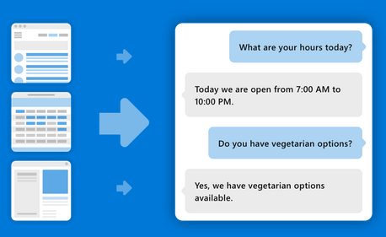
Intelligent Apps & Agents Demo
QnA Maker – www.qnamaker.ai

Slide 16
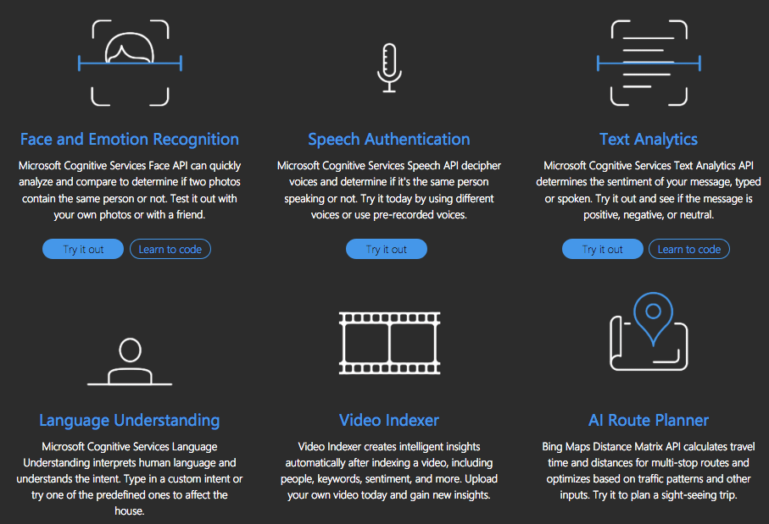
Cognitive Services Demos
https://aidemos.Microsoft.com

Slide 17
Knowledge Mining

Slide 18
What is knowledge mining?
Unlock valuable information lying latent in all your content
Form 5471

Slide 19
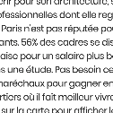


Knowledge mining with Azure Search
Documents
Cutting-edge AI
Fully text-searchable rich index
Key Phrase extraction
Location entity extraction
Sentiment analysis
Organization entity extraction
Persons entity extraction
Language detection
Face detection
Celebrity recognition
Tag extraction
Custom skills
Landmark detection
Printed text recognition

Slide 20
Knowledge mining: Reference Architecture
INGEST
STORE
AI
SERVE
Media (unstructured)
Natural Language Processing Image Processing Custom Models
Azure Data Factory
Azure Blob Storage
Cognitive Search (Azure Search)
Cosmos DB
Azure App Service
Web & mobile apps
Files (unstructured)

Slide 21






Customer examples
Canada’s largest automobile search site drives seamless search experience
Audio AI experts use cloud-based search platform to connect listeners to audio content
Prime property listings site powered by cloud-based search and analytics

Slide 22
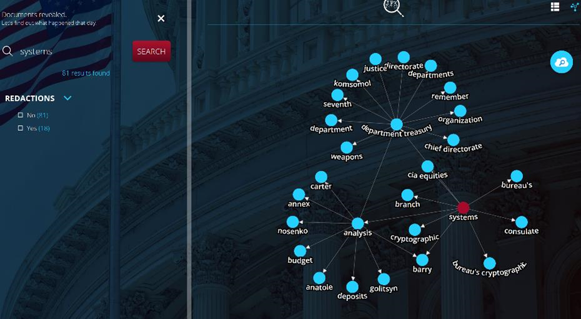
Knowledge Mining Demo
JFK Files
https://jfk-demo.azurewebsites.net/#/

Slide 23
Machine Learning

Slide 24






Machine learning on Azure
Sophisticated pretrained models
To accelerate solution development with easy to use pretrained models
…
Vision
Speech
Language
Search
Cognitive Services
Popular frameworks
Build sophisticated deep learning solutions
Pytorch
TensorFlow
Keras
Onnx
Productive services
Empower your development teams
Azure Databricks
Azure Machine Learning
Machine Learning VMs
Powerful infrastructure
Accelerate time to value
CPU
GPU
FPGA

Slide 25






Popular frameworks Build sophisticated deep learning solutions
Use your favorite deep learning frameworks
without getting locked into one framework
TensorFlow
PyTorch
Scikit-Learn
ONNX
Community project created by Facebook and Microsoft
Use the best tool for the job. Train in one framework and transfer to another for inference
MXNet
Chainer
Keras

Slide 26
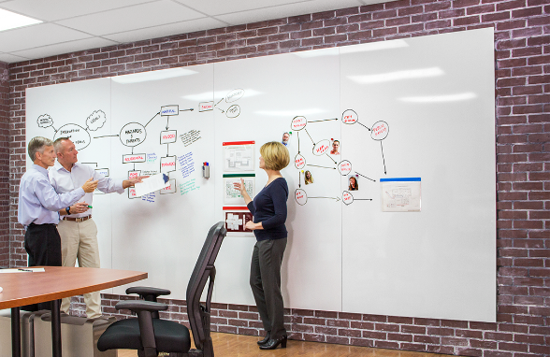


Productive services Empower your development teams
Integrated data science & data engineering teams
Desktop solutions not adequate
Need a unified big data & ML solution
Individual data scientists
Desktop solutions adequate
Need cloud for sporadic compute needs
+
Azure Databricks
Azure Machine Learning
Machine Learning VMs

Slide 27
Azure Databricks
Azure Machine Learning
Enable collaboration between data scientists and data engineers with an interactive productive workspace
Prepare and clean data at massive scale with the language of your choice
Build and train models with pre-configured machine learning and deep learning optimized clusters
Track experiments for reproducibility
and auditing needs. Identify and promote your best models
Deploy and manage your models using containers to run them anywhere

Slide 28

Powerful infrastructure Accelerate time to value
CPUs
GPUs
FPGAs
G
Ev3
M
NC
NCv2
NV
ND
FPGA
NCv3
NVv2
NDv2
(coming soon)
(coming soon)

Slide 29

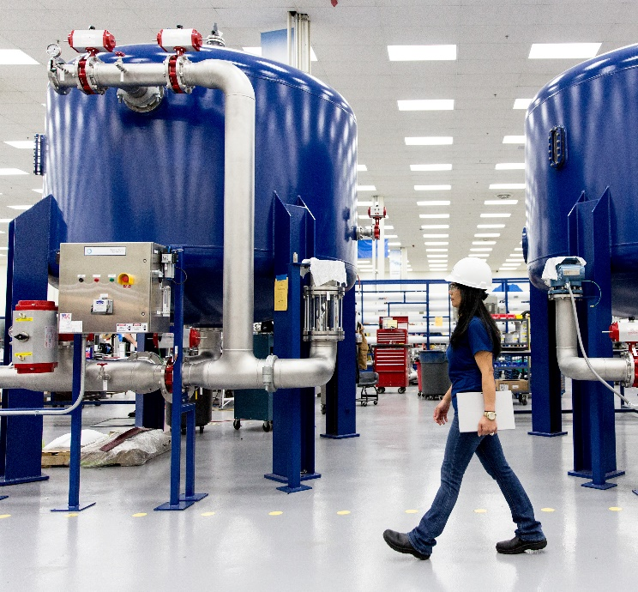




Customer examples
13M personalized experiences with 33 orders/second
$300k/day cost savings with predictive maintenance
85% savings in risk calculation & under-writing costs
50% lower loan defaults
Notes:
ASOS - - Personalized service to 13M, 33 orders per second
This section of the deck is meant to foster the conversation of what AI can do for the customer. The model that we use is the same one we already use for Digital Transformation. In fact, the key message to drive here is how AI accelerates that digital transformation by impacting in the four main pillars for it.

Slide 30
Azure AI
AI apps & agents
Knowledge mining
Machine learning
Azure Bot Service
Azure Cognitive Services
Azure Cognitive Search
Azure Databricks
Azure Machine Learning
Azure AI infrastructure

Slide 31

Our opportunity

Slide 32
Azure—cloud for all
Productive
Hybrid
Intelligent
Trusted

Slide 33
Thank you

